Slide 1

Presentation on,
Smart Traffic Management System
Skill Course: SET/CS/SC/C704
Mini Project
Hemwati Nandan Bahuguna Garhwal University (A Central University)
School of Engineering and Technology
Department of Computer Science and Engineering
Under the supervision of
Presented by
Prof. Premnath
Department of Computer Science and Engineering
Mr. Chhotelal Kushwaha
Mr. Arunabha Nag
Ms. Shweta Maurya
Department of Computer Science and Engineering
B.Tech. Seventh Semester

Slide 2
Presentation Outline
S. No. | Heading | Page Number
1 | Introduction & Background | 1
2 | Objectives & Scope | 2
3 | Existing System & Motivation | 3
4 | Methodology | 4
5 | Design & Implementation | 5
6 | System Architecture Diagram | 6
7 | Database Design / ER Diagram | 7
8 | User Flow Diagram | 8
9 | Results | 9-14
10 | Limitations & Future Work | 15
11 | References | 16
May 2026

Slide 3

1. Introduction and Background
Introduction
Background
Uses Artificial Intelligence (AI) and Computer Vision for traffic analysis.
Detects, tracks, and counts vehicles from traffic videos.
Analyzes traffic density and identifies congestion levels.
Provides real-time traffic insights for monitoring.
Supports better traffic-management decisions.
Aims to reduce congestion and improve traffic flow.
Increasing number of vehicles leads to frequent traffic congestion.
Traditional traffic monitoring often requires manual observation.
Traffic congestion causes delays, fuel wastage, and increased pollution.
AI and Computer Vision enable automated vehicle detection and tracking.
Smart traffic analysis supports efficient monitoring and better traffic-flow management.
1
Oct 2026

Slide 4
2. Objectives and Scope
Objectives
Scope
Automate vehicle detection, tracking, and counting.
Analyze traffic density and congestion levels.
Provide real-time traffic monitoring insights.
Improve traffic analysis using AI and Computer Vision.
Support better traffic-management decisions.
Analyze traffic videos captured by cameras.
Monitor vehicle movement and traffic volume.
Identify low, medium, and high traffic density.
Display traffic statistics for easier monitoring.
Support future integration with smart traffic signals and intelligent transportation systems.
2
May 2026

Slide 5
3. Existing System and Motivation
Existing System
Limitations
Motivation
Google Maps: Provides traffic conditions and route guidance.
Mappls: Offers mapping, navigation, and traffic-related services.
Traffic Police / ITMS: Uses traffic surveillance and management systems.
Eclipse SUMO: Simulates traffic flow but does not directly analyze uploaded real-world videos.
Limited focus on user-uploaded video analysis in these platforms.
Detailed vehicle-class counting may require a dedicated analysis tool.
Advanced traffic systems may require specialized infrastructure.
Automate vehicle detection, tracking, and counting.
Analyze traffic density and speed-related information.
Display traffic statistics through a web-based dashboard.
Enable future expansion to live CCTV and multi-road monitoring.
3
May 2026

Slide 6
4. Methodology
1. CCTV Video Input
Recorded .mp4 road traffic video file
2. OpenCV Frame Extraction & Preprocessing
Read frames at 30 FPS, resize & crop Region of Interest (ROI)
3. YOLOv8 Vehicle Detection Engine
Locate Cars, Bikes, Buses & Trucks with Bounding Boxes
4. ByteTrack Multi-Object Tracking
Assign persistent ID to each vehicle across consecutive frames
5. Speed & Line Crossing Calculation
Virtual line crossing count + 2-point pixel-to-meter speed (km/h)
6. Express REST API & MongoDB Storage
Save traffic metrics (count, avg speed, density, congestion level)
7. React Dashboard Output
Display live charts, counters, and congestion status indicator
4
May 2026

Slide 7
Technologies & Libraries We Used
Python 3.13 and OpenCV: Used to read video frames, draw boxes on screen, and perform image math.
2. Ultralytics YOLOv8: Pre-trained deep learning model used to detect vehicle bounding boxes instantly.
3. ByteTrack Algorithm: Tracks vehicles frame by frame so the same car isn't counted multiple times.
4. Node.js & Express API: Web server created to handle data storage and serve REST API endpoints.
5. MongoDB: Database used to store vehicle count logs, speed averages, and congestion reports.
6. React & Recharts: Used to build a clean web dashboard with charts, stats cards, and video control.
5
May 2026

Slide 8
6. System Architecture Diagram
LAYER 1: INPUT & VIDEO ACQUISITION LAYER
Raw Video Frames (RGB)
LAYER 2: AI PERCEPTION & COMPUTER VISION ENGINE (Python, PyTorch, YOLOv8)
REST JSON Payload / Webhook Callback
LAYER 3: BACKEND SERVICE & DATA PERSISTENCE LAYER (Node.js, Express, MongoDB)
HTTP REST API / JSON Telemetry
LAYER 4: PRESENTATION & MONITORING DASHBOARD LAYER (React 18, Vite, Recharts)
Figure 6.1 System Architecture Diagram
6
May 2026

Slide 9
LAYER 1: INPUT & VIDEO ACQUISITION LAYER
Traffic Video Ingestion
• Recorded CCTV (.mp4, .avi, .mov)
• Synthetic Traffic Generator
• Future: RTSP / IP Camera Feeds
OpenCV Preprocessing
• 30 FPS Frame Extraction
• Frame Resize & Normalization
• Polygonal ROI Spatial Masking
Camera & Road Config
• Road IDs & Lane Geometry
• Camera Resolution & FPS
• Virtual Line Coordinates (P1, P2)
Raw Video Frames (RGB) → to Layer 2

Slide 10
LAYER 2: AI PERCEPTION & COMPUTER VISION ENGINE
YOLOv8 Detection
• Deep Learning Model
• Car, Motorbike, Bus, Truck
• Bounding Box Inference
• Confidence Thresholding
ByteTrack Tracking
• Multi-Object Association
• Kalman Filter Prediction
• Hungarian Track Matching
• Unique Track ID Assignment
Line Crossing Engine
• Virtual Line Intersection
• 2D Vector Cross Product
• Direction A vs B Classify
• Duplicate-Proof Counting
Speed & Congestion
• 2-Point Calibrated Speed
• Velocity in km/h
• ROI Occupancy Density %
• Congestion State Rules
Annotated Video Generator (OpenCV VideoWriter)
Draws bounding boxes, track IDs, speed HUD & virtual tripwire
Structured Telemetry & Summary Generator
Produces structured JSON logs & frame-by-frame statistics
REST JSON Payload / Webhook Callback → to Layer 3

Slide 11
LAYER 3: BACKEND SERVICE & DATA PERSISTENCE LAYER
Express REST API Server
• /api/analysis/start & /upload
• /api/traffic/readings & /latest
• /api/roads & /api/cameras
Job Queue & AI Bridge
• Asynchronous Job Tracking
• ChildProcess CLI / FastAPI HTTP
• Real-Time Progress Streamer
Database Storage (Mongoose)
• Primary: MongoDB Atlas / Local
• Models: Road, Camera, Reading, Job
• Auto In-Memory Safety Fallback
HTTP REST API / JSON Telemetry → to Layer 4

Slide 12
LAYER 4: PRESENTATION & MONITORING DASHBOARD LAYER
Real-Time KPI Cards
Total Counts, Speed (km/h),
Flow Rate & Congestion Status
Recharts Analytics
Time-Series Flow Curves &
Vehicle Breakdown Bar Charts
Annotated Video Player
Real-Time Tracking Overlays
& Download Processed MP4
Audit Logs & Registry
Corridor Infrastructure Mgmt
& Historical Execution Logs

Slide 13
Figure 1.1: System Workflow
1. CCTV Video Input
Recorded .mp4 road traffic video file
2. OpenCV Frame Extraction & Preprocessing
Read frames at 30 FPS, resize & crop Region of Interest (ROI)
3. YOLOv8 Vehicle Detection Engine
Locate Cars, Bikes, Buses & Trucks with Bounding Boxes
4. ByteTrack Multi-Object Tracking
Assign persistent ID to each vehicle across consecutive frames
5. Speed & Line Crossing Calculation
Virtual line crossing count + 2-point pixel-to-meter speed (km/h)
6. Express REST API & MongoDB Storage
Save traffic metrics (count, avg speed, density, congestion level)
7. React Dashboard Output
Display live charts, counters, and congestion status indicator
Figure 1.1: System Workflow
7
May 2026

Slide 14
Project Folder Structure Overview
Folder Name | What It Contains in Simple Words
ai-engine/ | Python scripts for YOLOv8 detection, ByteTrack tracking, counting & speed math.
backend/ | Express API code, Mongoose MongoDB schemas, and job handling routes.
frontend/ | React components, dashboard pages, CSS styling, and Recharts graph modules.
data/ | Input sample traffic videos and generated output results/logs.
docs/ | Architecture documentation, API guide, and setup instructions.
9
May 2026

Slide 15




8. User Flow Diagram
Complete customer journey on ElectroShop
1
2
3
4
Upload Traffic Video
AI-Based Video Processing
Vehicle Detection and Traffic Analysis
View Results on Dashboard
User uploads a traffic video file for analysis.
AI and computer vision models process the video frame by frame.
Vehicles are detected, tracked and counted. Traffic density and congestion level are calculated.
Results, charts and traffic statistics are displayed on the web dashboard.
Car 45
Bike 28
Truck 8
Bus 5
Figure 8.1 User Flow Diagram
8
May 2026

Slide 16
1. Output
Detects and tracks vehicles in traffic videos.
Displays total and category-wise vehicle counts.
Analyzes traffic density and congestion levels.
Generates visual reports and traffic statistics.
Displays analysis results on a web dashboard.
1
Oct 2026

Slide 17
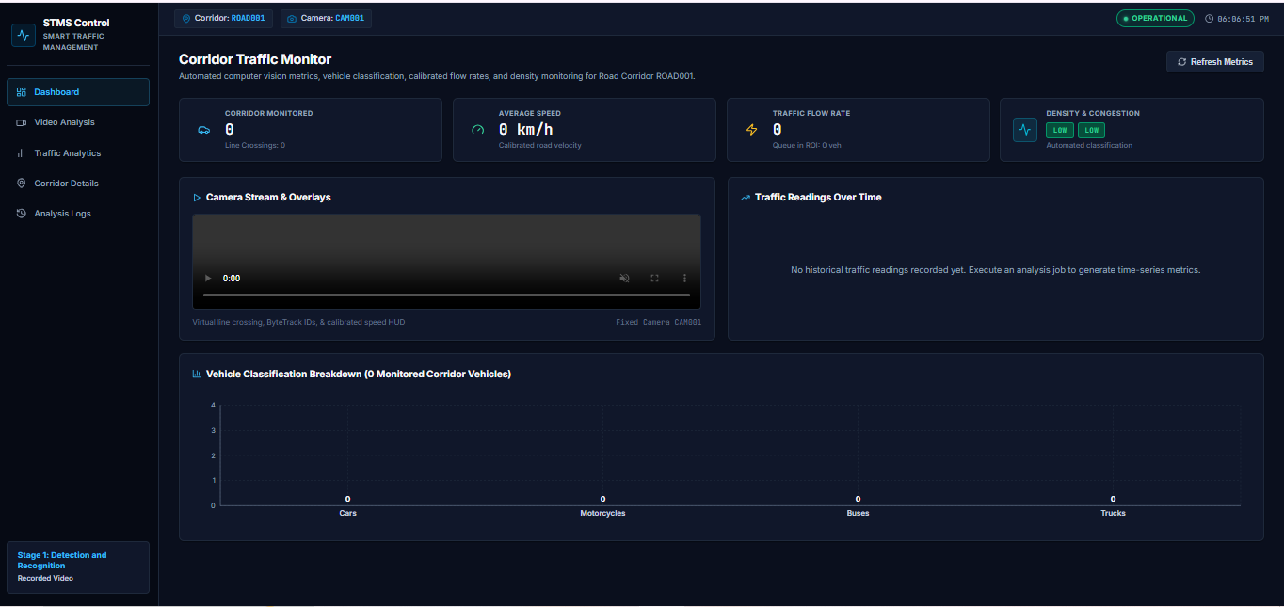

Slide 18
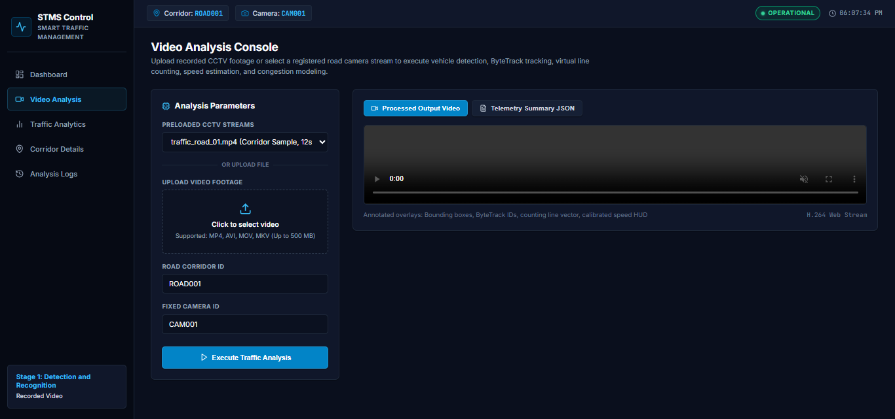

Slide 19
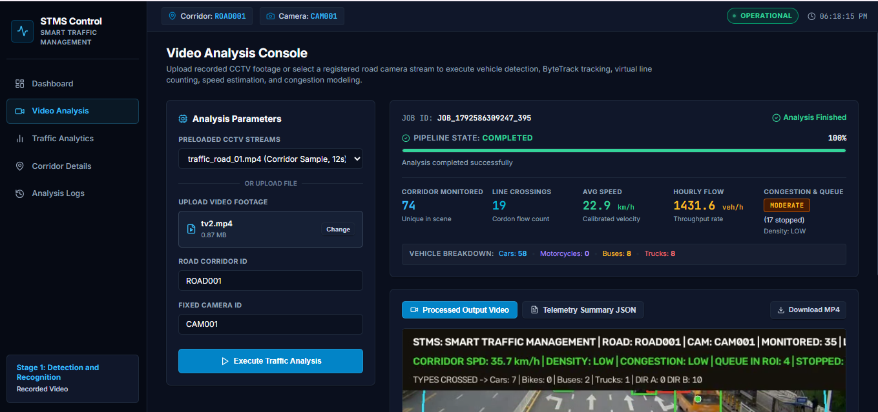

Slide 20
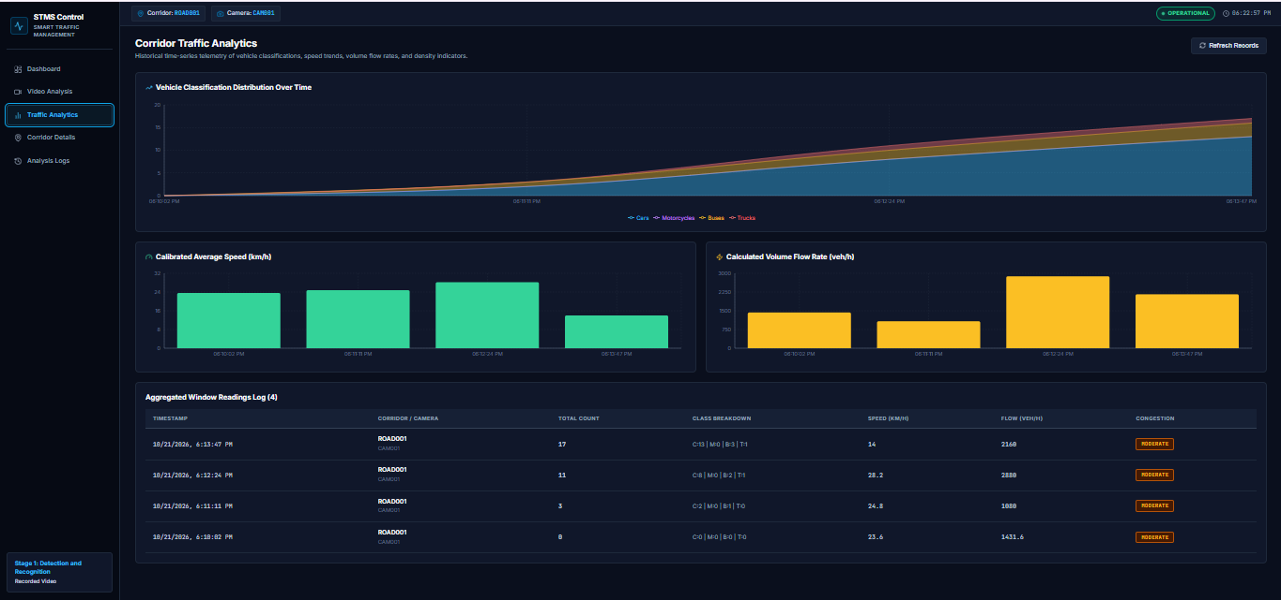

Slide 21
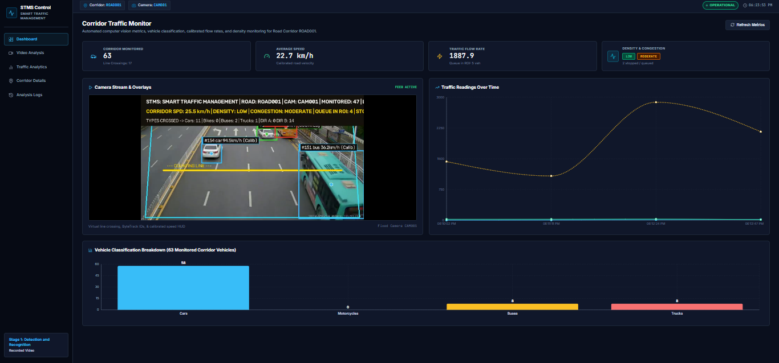

Slide 22
10. Limitations and Future Work
Current boundaries and planned improvements
Limitations
Future Work
Currently depends on uploaded traffic videos.
Detection accuracy may decrease in poor lighting or bad weather.
Processing speed depends on video quality and hardware.
Live CCTV integration is not yet implemented.
Multi-road junction management needs further development.
Integrate live CCTV cameras for real-time monitoring.
Connect multiple roads to a single junction
Implement adaptive traffic signal control.
Improve detection accuracy using advanced AI models.
Add emergency vehicle detection and priority management.
15
May 2026

Slide 23
11. References
Resources used during project development
• MDN Web Docs for HTML, CSS and JavaScript
• Node.js official documentation
• Express.js official documentation
• MongoDB Atlas documentation
• W3Schools web development tutorials
• Inspiration from e-commerce websites like Amazon and Flipkart
16
May 2026

Slide 24
Thank You
Questions?
Mr. Chhotelal Kushwaha
May 2026

